Slide 1
Gene Mutations

Slide 2
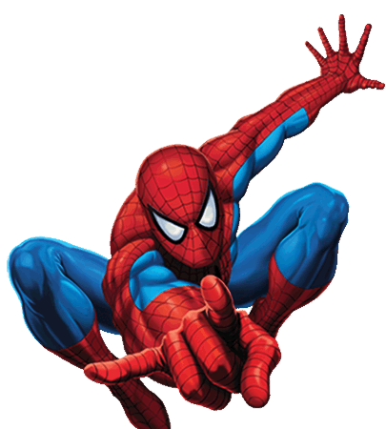
Apply your knowledge!
What happened to Peter Parkers genes after he was bitten by the spider?
What was the mutagen?
Peter Parker and Mary Jane had a baby, the baby did not develop any special ability. What does this say about Peter Parker’s mutation?

Slide 3
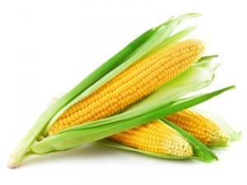
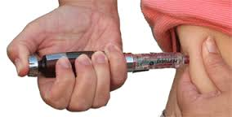
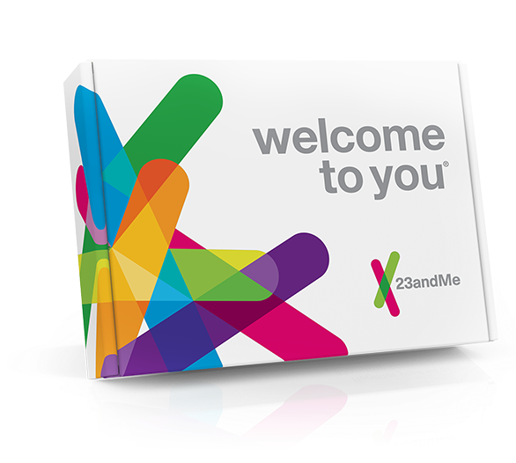

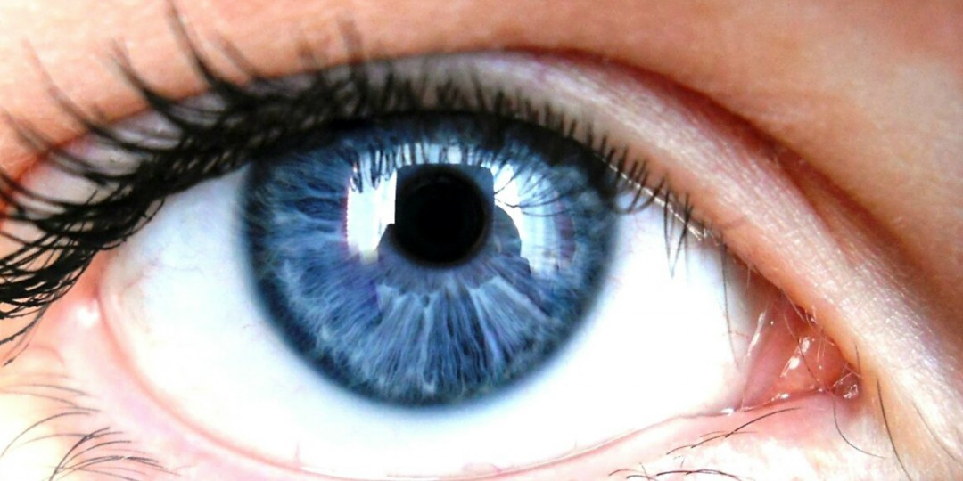
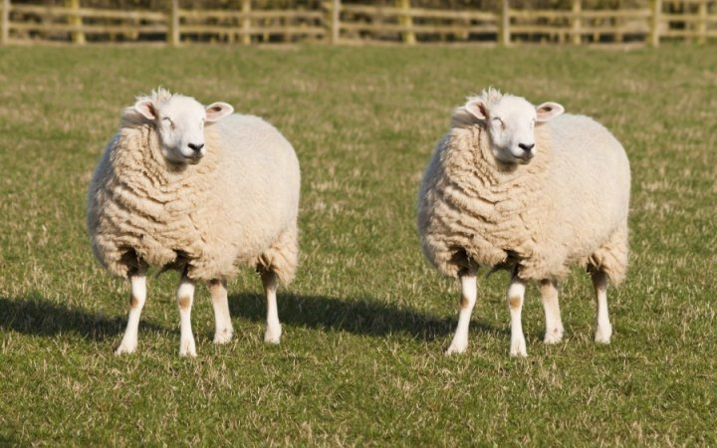
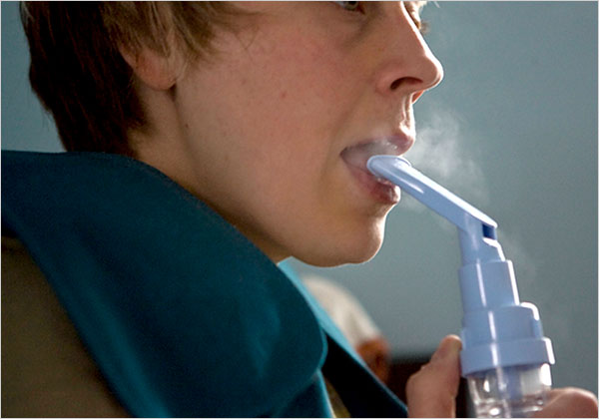


Slide 4
Quick quiz
What is the name given to a group of organisms of the same species living together in a particular place at a particular time?
Define a gene pool
What are the two main types of mutations?
Name one difference between somatic and germline mutations

Slide 5
Quick quiz
Population
The sum of all alleles in a given population
Gene and chromosomal
Somatic individuals affected, occurs in body cells Germline offspring affected, occurs in gametes

Slide 6
Gene mutations
Affects individual genes
Genes code for proteins
Disruption of base sequences may result in
No change
Change of protein structure
Disrupt protein production

Slide 7
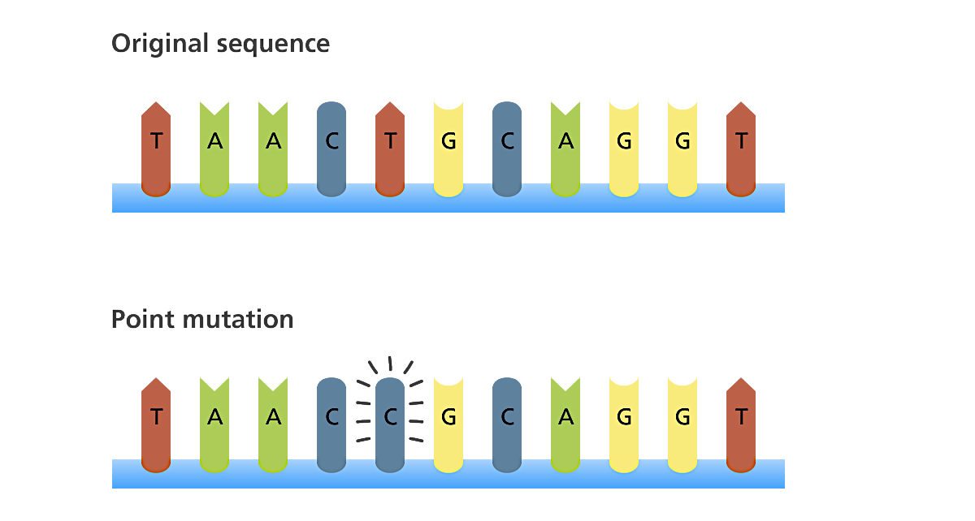
Point mutation
A change in just one base sequence

Slide 8
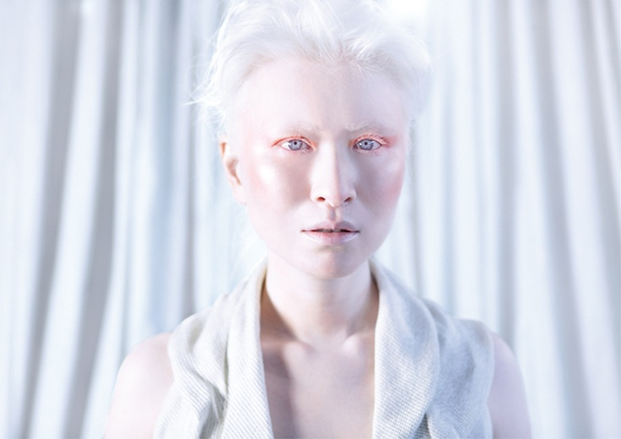

Slide 9
Albinism
Absence of pigment in hair, skin and eyes
Hair – whitish blonde
Skin – extremely pale
Eyes – pinkish
Mutation of the genes involved in melanin production

Slide 10
Duchenne Muscular Dystrophy
Mutation in mother which can be passed down to her son
Or mutation in the zygote
Wasting of muscles (legs first and later arms etc.)
Evident by 3-5 years due to muscle weakness
Death due to failure of respiratory muscles

Slide 11
Cystic Fibrosis
Mutation of gene found on chromosome 7
Gene codes for protein that regulates the passage for chloride ions across the cell membrane
Symptoms: salty-tasting skin; persistent coughing; wheezing or pneuomnia; digestive and other problems
Mutant allele is recessive

Slide 12
Lethal Recessives
Most gene mutations produce a recessive allele
Some mutations are lethal if they are not masked by a dominant normal allele
Causes death of embryo of foetus (miscarriage)

Slide 13
Tay-sachs disease (TSD) In Syllabus
Disorder of lipid metabolism
Autosomal recessive
Condition is lethal due to missing enzyme
Results in fatty substance in the nervous system
Symptoms: develop normally for first few months, deteriorates, mental and physical disabilities surface – death in early childhood

Slide 14
What would the frequency of the defective CF allele for be like in a gene pool? High or low frequency? Why so?

Slide 15
Cystic Fibrosis
According to the Cystic Fibrosis Foundation of Australia;
1 in 2500 babies are born with CF
1 in 25 people carry the CF gene

Slide 16
Gene Mutations
Three of the most common types of mutations are: 1. POINT MUTATION (one base is substituted for another)
If a point mutation changes the amino acid, it’s called a MISSENSE mutation.
If a point mutation does not change the amino acid, it’s called a SILENT mutation.
If a point mutation changes the amino acid to a “stop,” it’s called a NONSENSE mutation.
2. INSERTION (an extra base, or bases, is inserted)
3. DELETION (a base, or bases, is lost)
Deletion and insertion may cause what’s called a FRAMESHIFT, meaning the reading frame changes. These are typically one of the most serious types of mutations.

Slide 17
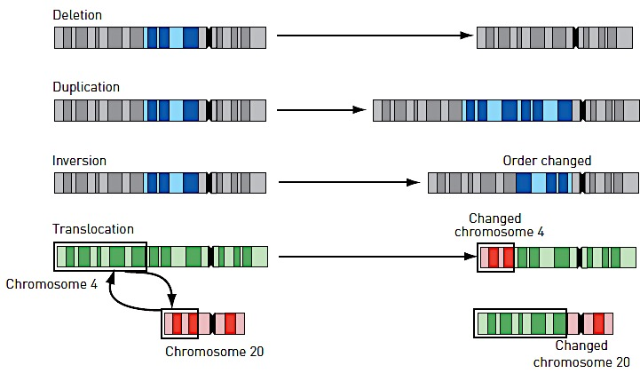
Chromosomal mutations

